Slide 1
Midterm Project
Quantized-Neural-Network-Acceleration-on-RV64IMC
115062504 莊景旗
Notes:
Hello, everyone. Today I’ll present my project for midterm part

Slide 2
Outline
Model info
Baseline analysis (B0)
Software optimization (B1)
xqmac8 instruction (X1)
xqrq instruction (X2)
Notes:
And this is outline

Slide 3
Outline
Model info
Baseline analysis (B0)
Software optimization (B1)
xqmac8 instruction (X1)
xqrq instruction (X2)
Notes:
First, I’ll talk about model info

Slide 4
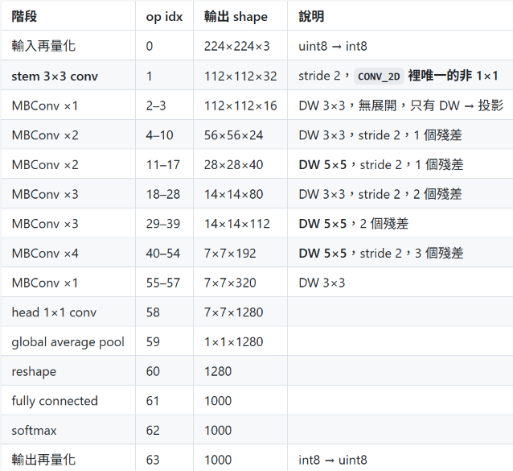
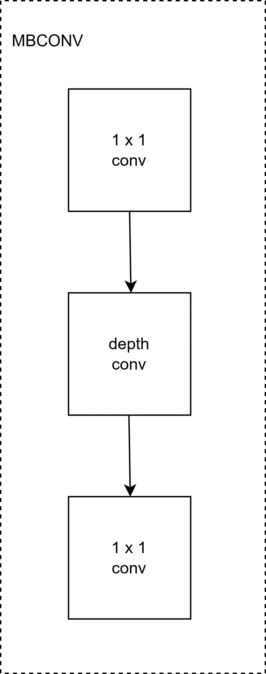
Model info
Model: EfficientNet-Lite0 (TFLite), W8A8 full-integer quantization
Optimize 1 x 1 conv and depthwise conv in software optimization
Notes:
I chose EfficientNet-Lite0 as the target model. It uses W8A8 full-integer quantization, so both weights and activations are int8.
The table shows the model architecture. It is mostly made of MBConv blocks, and each MBConv block is basically a 1×1 conv, a depthwise conv, and another 1×1 conv.
So in this project, I focus on these two kinds of layers: 1×1 conv and depthwise conv.

Slide 5
Outline
Model info
Baseline analysis (B0)
Software optimization (B1)
xqmac8 instruction (X1)
xqrq instruction (X2)
Notes:
And next I’ll talk about the baseline analysis

Slide 6
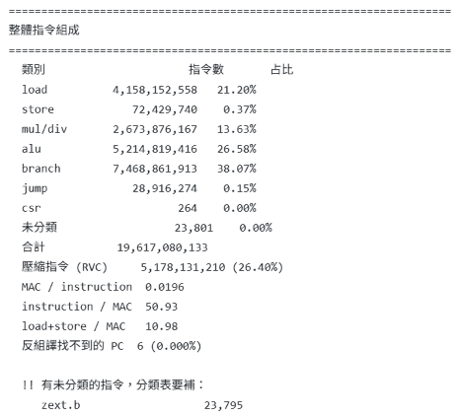
Baseline (B0)
Bottleneck:
10.98 load + store/MAC
38.07% branch instruction
50.93 Instruction / MAC (whole-program histogram)
Notes:
For the software optimization, I focus on 1×1 conv and depthwise conv. Let me start with 1×1 conv.
The picture shows the original TFLM convolution code, and I optimize three parts of it.
First, address calculation. TFLM calls Offset() to compute the address of every element. Each call needs three multiplies and three adds, and there are two calls per MAC. But in the inner loop, only the input channel changes, so the addresses are contiguous. So I compute the base pointer once outside the loop and just increment it inside. That turns six multiplies and six adds into one add.
Second, zero-point hoisting. TFLM adds the zero-point to every input before multiplying. If we expand the sum, the zero-point term becomes z times the sum of the weights, which does not depend on the pixel position. So I precompute it once per layer. The number of additions drops from OH·OW·OC·K to OC·K plus OH·OW·OC.
Third, 1×1 specialization. Since the kernel is 1×1, the two filter loops only run once, so I remove them. And since padding is zero, every coordinate is inside the image, so the boundary check can be removed too.

Slide 7
Outline
Model info
Baseline analysis (B0)
Software optimization (B1)
xqmac8 instruction (X1)
xqrq instruction (X2)
Notes:
And next I’ll talk about software optimization

Slide 8
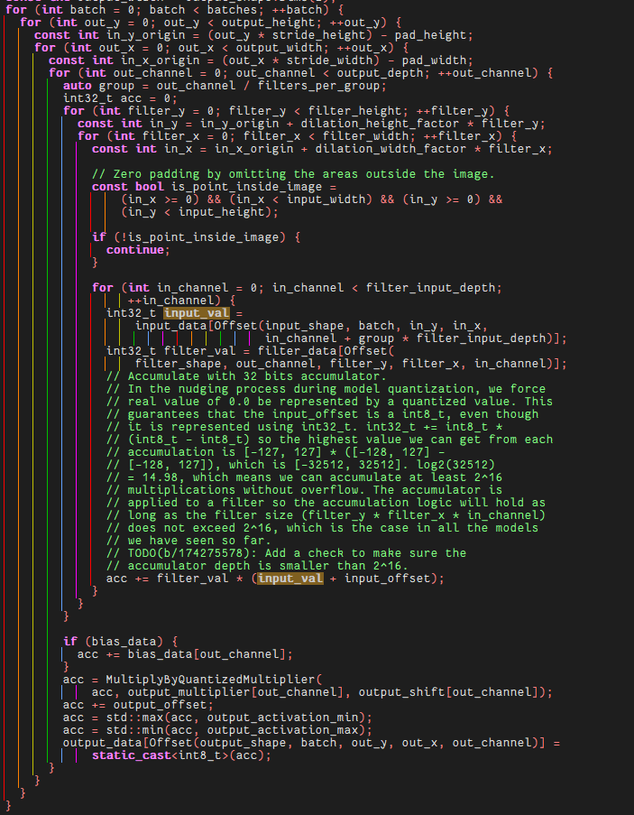
Software optimization (B1) – 1 x 1 conv
1. Address calculation: Offset() → pointer increment
Before: 2 Offset() calls per MAC, 6 multiplies + 6 adds
Observation: only in_channel varies in the inner loop, so addresses are contiguous
After: compute the base pointer once outside the loop, p++ inside — 1 add
2. Zero-point hoisting
Σ w·(a + z) = Σ w·a + z·Σw
z·Σw is independent of pixel position — precompute once per layer
Additions: OH·OW·OC·K → OC·K + OH·OW·OC
3. 1×1 specialization
1×1 kernel: the filter_y and filter_x loops run once → removed
padding = 0: every coordinate falls inside the image → boundary check removed
3
1
2
Notes:
For the software optimization, I focus on 1×1 conv and depthwise conv. Let me start with 1×1 conv.
The picture shows the original TFLM convolution code, and I optimize three parts of it.
First, address calculation. TFLM calls Offset() to compute the address of every element. Each call needs three multiplies and three adds, and there are two calls per MAC. But in the inner loop, only the input channel changes, so the addresses are contiguous. So I compute the base pointer once outside the loop and just increment it inside. That turns six multiplies and six adds into one add.
Second, zero-point hoisting. TFLM adds the zero-point to every input before multiplying. If we expand the sum, the zero-point term becomes z times the sum of the weights, which does not depend on the pixel position. So I precompute it once per layer. The number of additions drops from OH·OW·OC·K to OC·K plus OH·OW·OC.
Third, 1×1 specialization. Since the kernel is 1×1, the two filter loops only run once, so I remove them. And since padding is zero, every coordinate is inside the image, so the boundary check can be removed too.

Slide 9
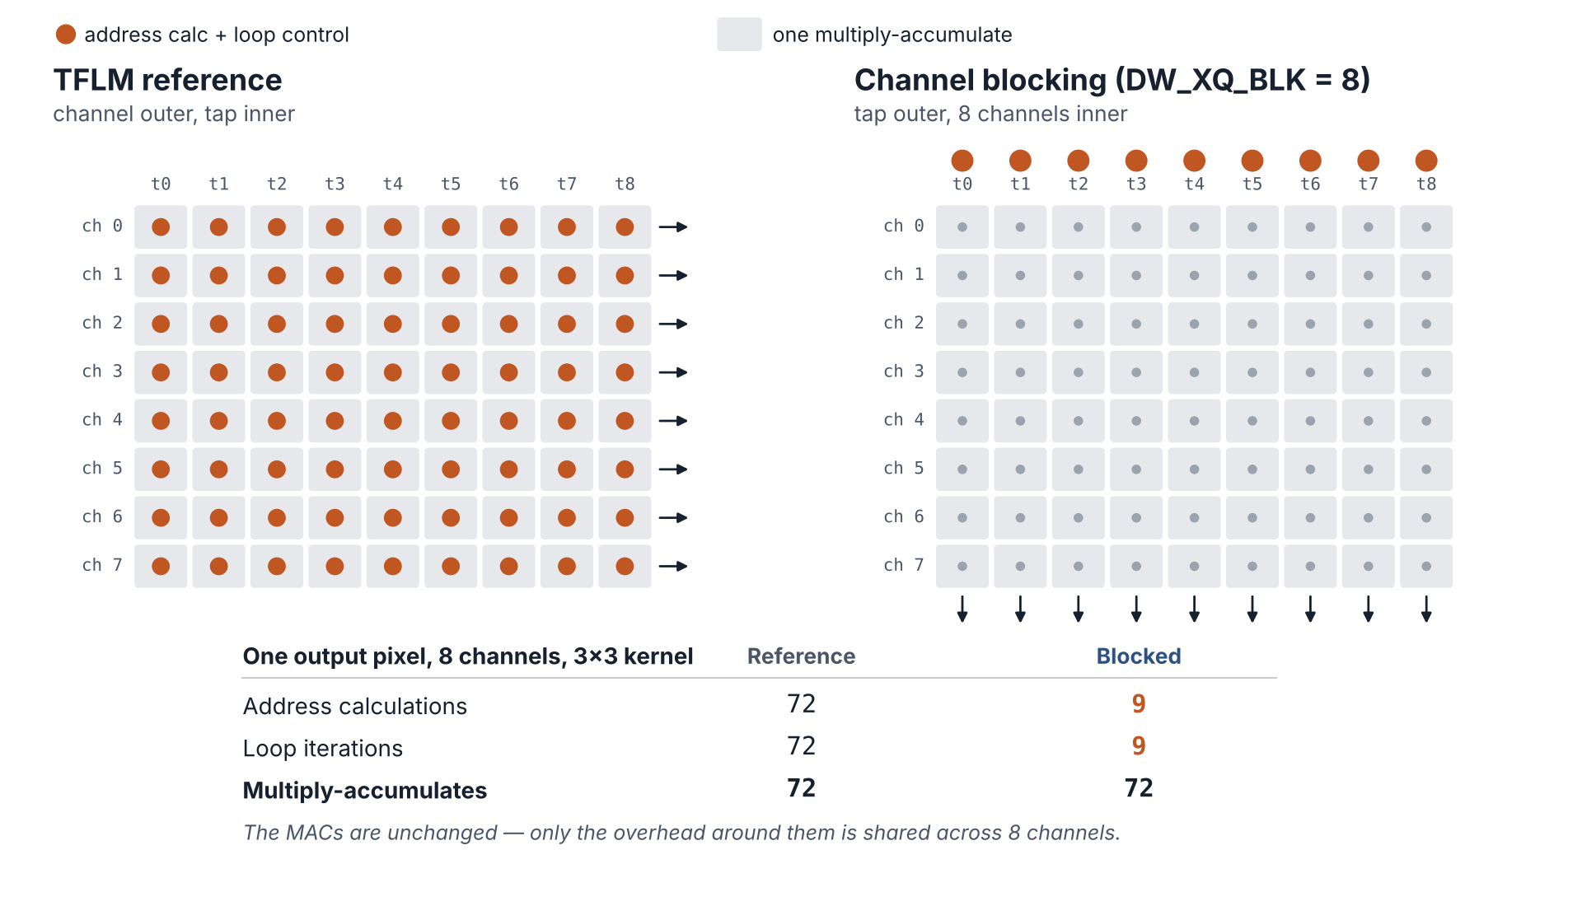
Software optimization (B1) – depthwise conv
1. Address calculation: Offset() → incremental addressing
2. Zero-point hoisting + bounds-check removal for interior pixels
(border pixels keep the reference path)
3. Channel tiling + loop interchange
Notes:
Next is depthwise conv. The first two optimizations are similar to 1×1 conv.
First, I replace Offset() with incremental addressing.
Second, I hoist the zero-point and remove the bounds check, but only for interior pixels. Border pixels need padding, so they still go through the reference path.
The third one is different: channel tiling with loop interchange. In depthwise conv, each channel is computed independently, and in NHWC layout the channels are contiguous in memory. So instead of looping channel by channel, I process 8 channels together for each kernel tap.
As the figure shows, for one output pixel with 8 channels and a 3×3 kernel, the address calculations and loop iterations go from 72 to 9, while the number of MACs stays the same. So the overhead is shared across 8 channels.

Slide 10
After software optimization (B1)
Metric | B0 | B1 | reduction
Instructions (Invoke) | 19,575,565,013 | 3,682,312,012 | 5.32x
Instructions / MAC | 50.82 | 9.56 | 5.32x
Load + Store / MAC | 10.98 | 2.42 | 4.54x
Load | 4,158,152,558 | 909,671,014 | 4.57x
Store | 72,429,740 | 22,020,698 | 3.29x
Mul / div | 2,673,876,167 | 429,435,354 | 6.23x
ALU | 5,214,819,416 | 1,660,480,278 | 3.14x
Branch | 7,468,861,913 | 684,650,331 | 10.91x
Notes:
This table compares B0 and B1.
After the software optimization, the total instruction count drops 5.32 times, from 50.82 to 9.56 instructions per MAC.
Loads and stores per MAC drop from 10.98 to 2.42.
Branch has the largest reduction, 10.91 times, because the filter loops and the boundary checks are removed.

Slide 11
Outline
Model info
Baseline analysis (B0)
Software optimization (B1)
xqmac8 instruction (X1)
xqrq instruction (X2)

Slide 12
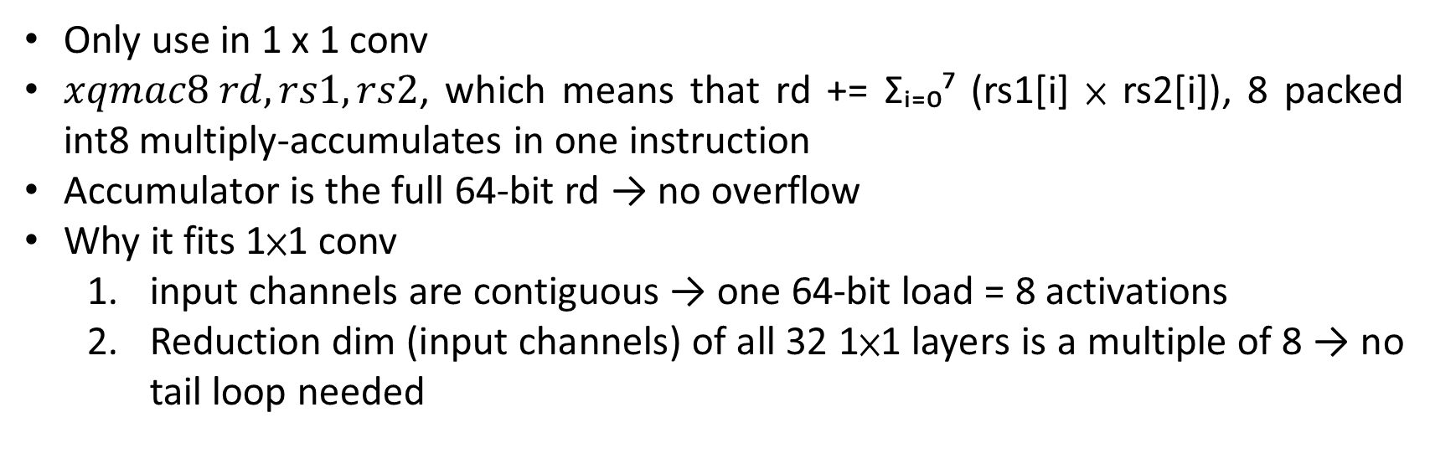
xqmac8 instruction (X1)
Only use in 1 x 1 conv
$xqmac8 rd, rs1, rs2$, which means that rd += Σᵢ₌₀⁷ (rs1[i] × rs2[i]), 8 packed int8 multiply-accumulates in one instruction
Accumulator is the full 64-bit rd → no overflow
Why it fits 1×1 conv
  input channels are contiguous → one 64-bit load = 8 activations
  Reduction dim (input channels) of all 32 1×1 layers is a multiple of 8 → no tail loop needed
Notes:
xqmac8 does 8 int8 multiply-accumulates in one instruction.
rs1 and rs2 are 64-bit registers, and each holds 8 int8 values. The instruction multiplies the 8 pairs, adds up the products, and accumulates the result into rd.
It is only used in 1×1 conv, for two reasons. First, in NHWC layout the input channels are contiguous, so one 64-bit load gets 8 activations. Second, the number of input channels of all 32 1×1 layers is a multiple of 8, so no tail loop is needed.
Depthwise conv can't use it, because it doesn't sum across channels.

Slide 13
After doing xqmac8 instruction (X1)
Metric | B0 | B1 | X1 | B1→X1 | B0→X1
Instructions (Invoke) | 19,575,565,013 | 3,682,312,012 | 1,590,153,616 | 2.32x | 12.31x
Instructions / MAC | 50.82 | 9.56 | 4.13 | 2.32x | 12.31x
Load + Store / MAC | 10.98 | 2.42 | 0.87 | 2.76x | 12.55x
Load | 4,158,152,558 | 909,671,014 | 313,278,395 | 2.90x | 13.27x
Store | 72,429,740 | 22,020,698 | 23,734,919 | 0.93x | 3.05x
Mul / div | 2,673,876,167 | 429,435,354 | 90,897,872 | 4.72x | 29.42x
ALU | 5,214,819,416 | 1,660,480,278 | 747,486,043 | 2.22x | 6.98x
Branch | 7,468,861,913 | 684,650,331 | 396,543,266 | 1.73x | 18.83x
xqmac8 |  |  | 42,317,184
Notes:
With xqmac8, the instruction count drops another 2.32 times, from 9.56 to 4.13 instructions per MAC. Compared with B0, that's 12.31 times.
Mul/div drops the most, 4.72 times, because 8 multiplies are now done in one instruction.
xqmac8 is executed 42,317,184 times. Times 8, that is exactly the number of MACs in all 1×1 layers, so every 1×1 MAC goes through xqmac8.
The overall speedup is smaller than for the 1×1 layers alone, because the stem and depthwise layers are not accelerated by this instruction.

Slide 14
Outline
Model info
Baseline analysis (B0)
Software optimization (B1)
xqmac8 instruction (X1)
xqrq instruction (X2)

Slide 15
xqrq instruction (X2)
Used in both 1×1 conv and depthwise conv
Requantization: fixed-point multiply → rounding → shift → add zero-point → clamp
Combine above 5 steps into 1 instruction
rs2: 64-bit descriptor, packed once per layer ([63:32] multiplier | [31:24] shift | [23:16] offset | [15:8] min | [7:0] max)
Notes:
After X1, requantization becomes noticeable. For every output element, we need to convert the int32 accumulator back to int8. This takes five steps: fixed-point multiply, rounding, shift, add the zero-point, and clamp.
xqrq combines these five steps into one instruction. rs1 is the int32 accumulator, and rd is the int8 result.
The five parameters are packed into one 64-bit descriptor in rs2. The descriptor is packed once per layer and reused for every output element.
Unlike xqmac8, xqrq is used in both 1×1 conv and depthwise conv, since every output needs requantization.

Slide 16
After doing xqrq instruction (X2)
Metric | B0 | X1 | X2 | X1→X2 | B0→X2
Instructions (Invoke) | 19,575,565,013 | 1,590,153,616 | 1,271,170,850 | 1.25x | 15.40x
Instructions / MAC | 50.82 | 4.13 | 3.30 | 1.25x | 15.40x
Load + Store / MAC | 10.98 | 0.87 | 0.81 | 1.08x | 13.61x
Load | 4,158,152,558 | 313,278,395 | 283,551,893 | 1.10x | 14.66x
Store | 72,429,740 | 23,734,919 | 27,207,345 | 0.87x | 2.66x
Mul / div | 2,673,876,167 | 90,897,872 | 78,225,289 | 1.16x | 34.18x
ALU | 5,214,819,416 | 747,486,043 | 518,188,400 | 1.44x | 10.06x
Branch | 7,468,861,913 | 396,543,266 | 352,213,721 | 1.13x | 21.21x
xqmac8 |  | 42,317,184 | 42,317,184
xqrq |  |  | 6,336,288
Notes:
With xqrq, we go from 4.13 to 3.30 instructions per MAC, which is 15.40 times faster than B0.
ALU drops the most here, because the shift, rounding, add and compare steps are now inside xqrq.
xqrq is executed 6,336,288 times, which equals the number of conv output elements except the stem.
All configurations produce bit-exact results compared with the TFLM golden output.

Slide 17
Kernel microbenchmark (instructions / mac)
Kernel | B0 | X2 | Speedup
1 x 1 conv (K = 192) | 10.414 | 0.923 | 11.27x
1 x 1 conv (K = 48) | 11.659 | 1.134 | 10.28x
Depthwise (14 x 14 x 240) | 29.124 | 11.005 | 2.64x
Depthwise (28 x 28 x 96) | 29.475 | 9.059 | 3.25x

Slide 18
Future Work
 | Instruction | MAC | Instruction/MAC
Stem 3 x 3 | 521,054,588 | 10,838,016 | 48.08
1 x 1 conv | 379,689,646 | 338,537,472 | 1.12
Depthwise conv | 331,268,350 | 34,532,064 | 9.59

